Slide 1
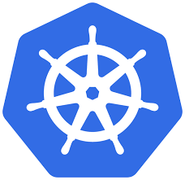
Presenter: Jitendra Singh Tomar
Kubernetes
Presented by:
Pioneer Business Solutions

Slide 2
Agenda
What is Kubernetes?
Kubernetes basics.
Where Kubernetes is useful?
What are its key features of Kubernetes?
What are its key benefits of Kubernetes?
Kubernetes Architecture.
Kubernetes concepts.
Kubernetes Objects

Slide 3
What is Kubernetes ???
Kubernetes is an open-source container orchestration platform that helps
Automate the deployment,
Scaling and Management of containerized applications.
It was originally developed by Google and is now maintained by the Cloud Native Computing Foundation (CNCF).
AKA “K8s”.

Slide 4
What is Kubernetes ???
Kubernetes provides a powerful framework for
managing containerized workloads and services,
allowing organizations to build scalable and resilient application architectures.
The main building block of Kubernetes is the container.
Containers are lightweight, isolated execution environments that package an application and its dependencies.
Kubernetes allows you to deploy these containers into a cluster of machines, called nodes.
These nodes can be physical machines or virtual machines running in a cloud environment.

Slide 5
Kubernetes features:
Container Orchestration
Scaling and Load Balancing
Service Discovery and Load Balancing
Self-Healing
Rolling Updates and Rollbacks
Storage Orchestration
Secrets and Configuration Management

Slide 6
Where Kubernetes is useful?
Containerized Application Deployment
Scalability and High Availability
Microservices Architecture
Multi-Cloud and Hybrid Cloud Environments
Development and Testing Environments
CI/CD Pipeline
Big Data and AI/ML Workloads
Internet of Things (IoT) Applications

Slide 7
Kubernetes benefits
Scalability and Elasticity
High Availability and Fault Tolerance
Automated Deployments and Rollbacks
Container Orchestration and Management
Service Discovery and Load Balancing
Storage Orchestration
Infrastructure Flexibility
Ecosystem and Community Support
DevOps Enablement
Cost Efficiency

Slide 8
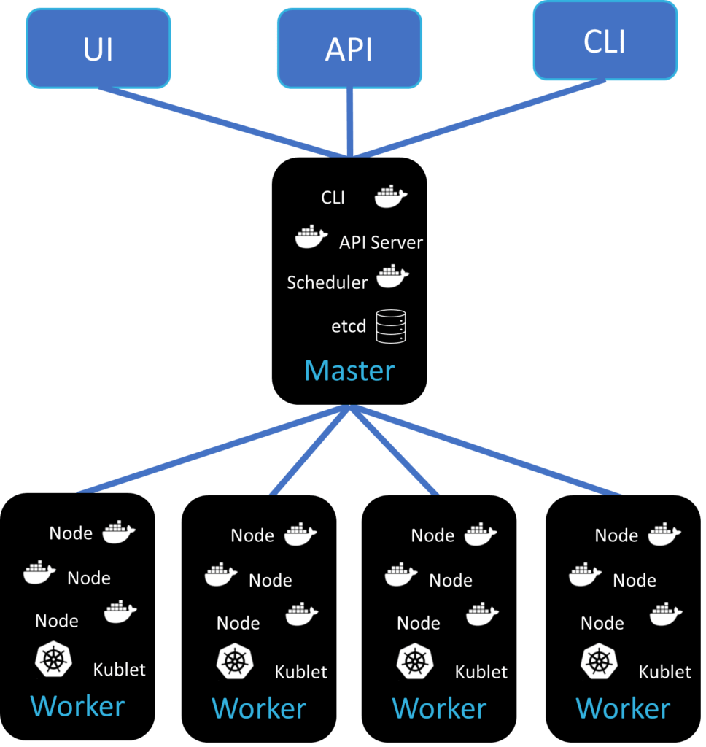
Kubernetes Architecture

Slide 9
Kubernetes Architecture components:
Master Node
API Server
Scheduler
Controller Manager
etcd
Worker Nodes
Kubelet
Container Runtime
kube-proxy
Networking
Add-ons
Dashboard
Ingress Controller
DNS
Metrics Server
Pods

Slide 10
Kubernetes Objects
Objects are the persistent entities that represent the desired state and configuration of the cluster's resources.
They are the building blocks used to define and manage the applications and infrastructure within the Kubernetes environment.
Kubernetes objects are defined using YAML or JSON manifests and are submitted to the Kubernetes API server for processing. Here are some commonly used Kubernetes objects:
Pod
Deployment
Service
Namespace
ConfigMap
Secret
PersistentVolume (PV) and
PersistentVolumeClaim (PVC)
Ingress
Job and CronJob

Slide 11
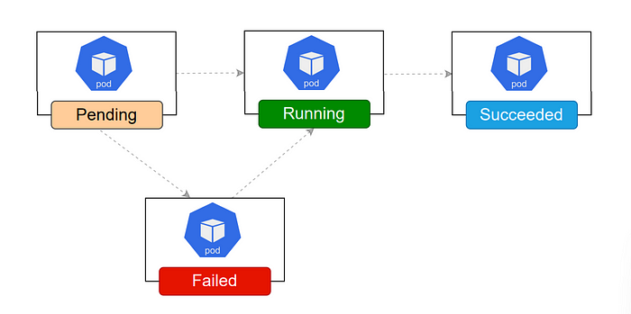
Life cycle of a pod
A pod is the smallest and most basic unit of deployment.
It represents a single instance of a running process within the cluster.
The life cycle of a pod can be divided into several stages:
Creation
Pending
Scheduled
Container creation
Running
Succeeded/Failed
Termination
Deletion

Slide 12

Thank You

